Slide 1


“Train the trainer”
Presented by
EFI & Nick Verlies
coaching camp New Delhi
March 21-25,2016

Slide 2
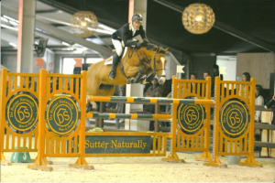
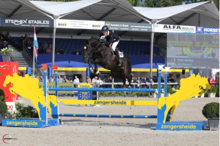
Introduction Nick Verlies
Extensive background as a trainer of International horses and riders
Competes at the Grand Prix level and qualified multiple times for the World Championship of young jumping horses
Breeder, owner and trainer of several international show jumping horses

Slide 3
Day 1
1.Introduction and objectives
2.Theories & methods of ground training
( 9 points of development)
3.Theories & methods of lunging and long lining
When and why to lunge a young horse
When and why to lunge an older horse
4. Basic principles of coaching and mentoring

Slide 4
9 points of development
1-Obedience
2-Relaxation
3-Regularity
4-On the leg
5-Supple Connectivity
6-Accepting the bit
7-Straightness
8-Collection
9-Uphill & forward
  movement

Slide 5
Day 2
Flat work and gymastics
Set up : 2 trainers are riding and the others are observers
4 sessions of 1-1,5 hour followed by classroom session to discuss the day , evaluation of videos and question and answer session
Most important exercises to achieve a specific goal or address a specific problem
Observer need to learn how to diagnose a problem
They than need to learn how to use the right exercise to solve the problem

Slide 6
Day 3
Course oriented day , building on the achievenments of the previous day
Set up : 2 trainers are riding and the others are observers
4 sessions of 1-1,5 hour followed by classroom session to discuss the day , evaluation of videos and question and answer session
Most important exercises to achieve a specific goal or address a specific problem
Observer need to learn how to diagnose a problem
They than need to learn how to use the right exercise to solve the problem

Slide 7
Day 4 ( same as day 2 but with part II of the trainers)
Flat work and gymastics
Set up : 2 trainers are riding and the others are observers
4 sessions of 1-1,5 hour followed by classroom session to discuss the day , evaluation of videos and question and answer session
Most important exercises to achieve a specific goal or address a specific problem
Observer need to learn how to diagnose a problem
They than need to learn how to use the right exercise to solve the problem

Slide 8
Day 5( same as day 3 but with part II of the riders )
Course oriented day , building on the achievenments of the previous day
Set up : 2 trainers are riding and the others are observers
4 sessions of 1-1,5 hour followed by classroom session to discuss the day , evaluation of videos and question and answer session
Most important exercises to achieve a specific goal or address a specific problem
Observer need to learn how to diagnose a problem
They than need to learn how to use the right exercise to solve the problem

